Slide 1
Guideline for ClinLabGeneticist tool
Jinlian Wang
Jinlian.wang@mssm.edu

Slide 2
Backend Database Setup
For user install the software easily, we provide Microsoft Access 2010 (named wes.accdb) as the backend database instead of MySQL.
Just put the execute file and wes.accdb together in a same folder.
Make sure the Access database is enabled ( see next slide) before using the tool.
Click the ClinLabGeneticst.exe . Then you will open the software.

Slide 3
Click ‘Enable Content’
If you met some problem such as “‘Microsoft.ACE.OLEDB.12.0″, please install AccessDatabaseEngine by google

Slide 4
http://rongchenlab.org/software/clinlabgeneticist/
1. Download

Slide 5
Unzip and “Install”
Make sure ClinLabGeneticist and wes.accdb in the same folder. Otherwise, the tool will not work

Slide 6
Double click “ClinLabGeneticist1.9Beta.exe” to start installation
Click ‘Next’

Slide 7
Installation path selection
You can use the default directory and click”Next”

Slide 8
Installing…
Installing…

Slide 9
Installation done
Installed successfully. Click “Close”
After ‘Close’, please check your desktop

Slide 10
Sign in
User name is gmail email
Default password is CLG4reviewer
Pull down the menu and select Reviewer
Click ‘Sign in’

Slide 11
Reviewer Panel
Click this to change your password
Exit
Click and Start reviewing your assignments
Your Reviewed Assignments Browse

Slide 12
Assignments interface
If your assignment is not submitted, the status is ‘Modified’
Click to start review
Not completed assignment
New assignment

Slide 13
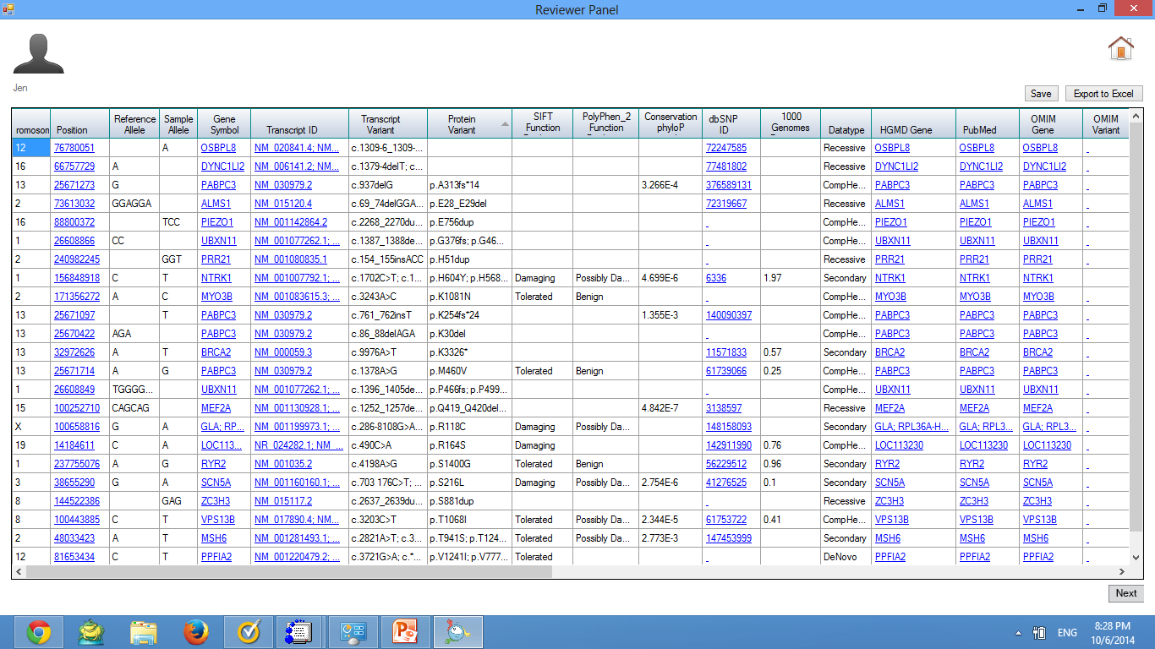
Reviewer’s master table
Go Home
Save your assignment
Export assignment to excel
Click ‘Next’ to submit your assignment

Slide 14
What does the master table function ?
Master table help you to diagnose each variants & make decision based on some evidence.
Check the detailed position information and structure of the variants through UCSC Genome browser.
Look at the latest publication for each variants
Review the pathogenic information of each variants from HGMD, OMIM, GeneCard, ClinVar at both gene and variants levels
Provide population frequency information for each variants from ESP6500, 1k genomes.
Allow you to check the detailed information of each variants though embedded IGV browser.
Comment with your expertise opinion on each variants.
Auto save the assignments every five minutes
Export your assignments in the format of excel.

Slide 15
Functions include: 1) sort : click small triangle in the header of each column 2) adjust the width of each column same as excel 3) freeze column: select the column you want to freeze, right click the header, and put your mouse within the popup window, 4) Hide column: same as 3), check the column you want to hide, 5) Comments: right click the cell you want to add comments, once the color is blue indicating the cell selected and you can make comments.
Click the header to sort each column
Right click the header to Freeze/add /remove columns
Right click the cell to add comments
Small icon indicates the comment made
Mouse over each cell show the out sourced link
Auto save

Slide 16
Submission
Export your assignment to excel
Conform your submission
Click ‘Next’ to submit your assignment

Slide 17
Exported excel file

Slide 18
Submitted successfully
Submitted successfully, a email will automatically send to administrator

Slide 19
History browse
Click to browse the history

Slide 20
Comments and Feedback
Please contact me if you need source code by email:
jinlian.wang@mssm.edu

